Slide 1

Demystifying Azure AD, JWTs & OIDC
Graeme Foster
Cloud Solution Architect @ Microsoft

Slide 2
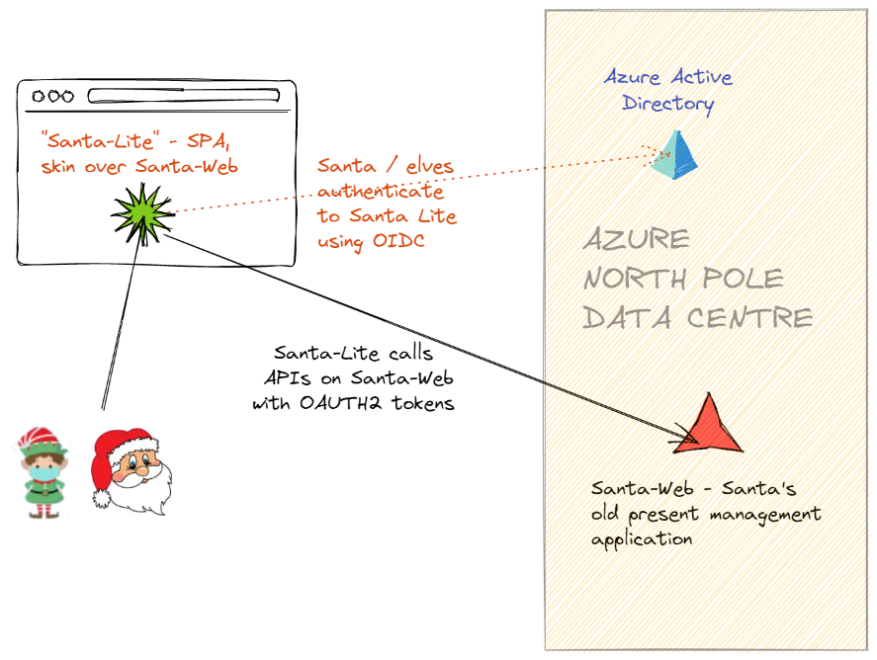
The scenario…

Slide 3
Resources
https://docs.microsoft.com/en-us/azure/active-directory/develop/v2-oauth2-auth-code-flow
https://nicolgit.github.io/AzureAD-Endopoint-V1-vs-V2-comparison/
https://brockallen.com/2019/01/03/the-state-of-the-implicit-flow-in-oauth2/
https://docs.microsoft.com/en-us/azure/active-directory/develop/msal-migration
https://docs.microsoft.com/en-us/azure/active-directory/develop/howto-add-app-roles-in-azure-ad-apps

